Slide 1

RETENCION– TELCO Customer Churn Management
HARMAN CONNECTED SERVICES
ENABLING A WORLD OF CONNECTED EXPERIENCES
Copyright © 2015 HARMAN. All rights reserved. CONFIDENTIAL AND PROPRIETARY

Slide 2
Objective
Objective: Build end to end analytical solution framework to help Telco's for customer retention
Input Data:
Our solution will have ability to consume data from multiple sources with predefined list of attributes as input from following
Customer Billing information
Customer complaints
CDR data
Signal strength data
Customer demography data
Output: It will estimate PTC (Propensity to Churn prediction) for each customer

Slide 3
Solution Features
Option for guided pre-processing and model selection
Web Services API to help access from any device
Reports on:
Customer risk profiling over time
Customer segments who are in high risk of churn by geography, demography product subscription etc.
Factors affecting churn by each customer segment

Slide 4
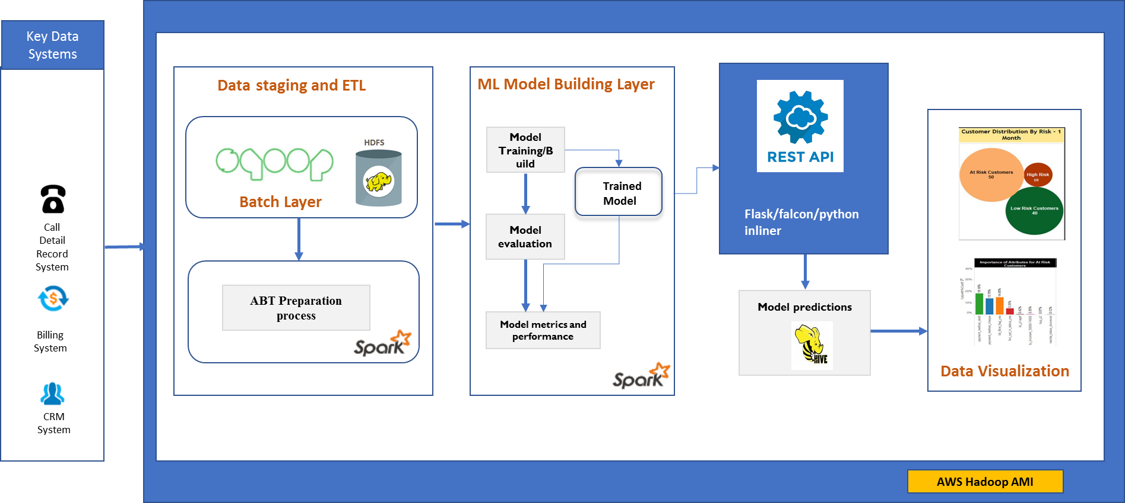
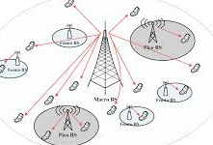

RETENCION - Solution Architecture
Network data

Slide 5
RETENCION - Project Plan
Week |  | 1 | 2 | 3 | 4
Milestone I | Infrastructure Set up
 | Development Environment set up
 | Hadoop Set up (Spark, Python, Hive, pySpark, Rest API)
Milestone II | Product Development
Task 1 | Data Creation & Understanding
 | Data Sourcing realted to chrun
 | Code Development for loading raw data into HDFS
 | correlation between dependent and independent variable
 | Missing & outlier value
 | Exploratory Data Analysis
 | Testing and fixing the code
Task 2 | Data Preparation
 | Transformation
 | Missing & outlier treatment
 | Binning
 | Feature Engineering
 | Testing and fixing the code
Task 3 | Model Building
 | Code Development for selecting required classification Algorithm.
 | Model Deployment using Rest API
 | Backgroud processing and storing the output
 | Testing and fixing the code
Task 4 | Data Visualization
 | Propensity Segmentation for likelyhood to churn
 | Customer Profiling with each risk zone of attrition
 | Change in propensity over time (Based on data availability)

Slide 6
Appendix

Slide 7
Infrastructure Requirement
AWS Server
32GB RAM
40GB Disk Space
Single Node Cloudera VM
Python 2.7/3 with necessary Hadoop ecosystems

Slide 8
Data Dimension

